Slide 1
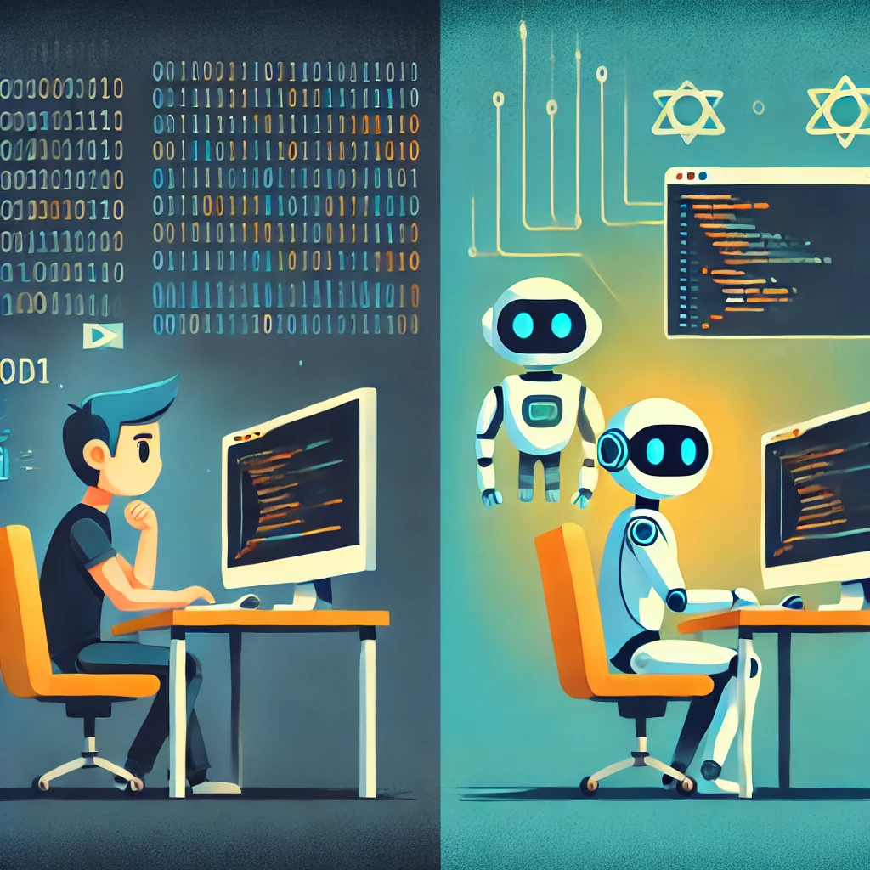
Will AI make programming jobs redundant?
AI can make programming job redundant, because:
But...
Quickly solve low-to-medium difficulty code problems and quickly generate target code
Within limited iterations, the solution generated by difficult code is not ideal(Brandon 2023)
Allowing programmers to test their applications more rapidly and precisely.
AI relies on existing data and lacks the communication skills of program
practitioners(Myers et al. 2023)
Beginners can learn programming at a lower cost, and positions such as programming educators have become redundant..
Low accuracy, low performance, and low maintenance of AI-generated code
In the short term, AI will not make programming jobs redundant. This is due to their(practitioner) unique creativity and communication skills. AI can be their partner, and the future will be pair programming.
....
my position and
conclusion

